Slide 1
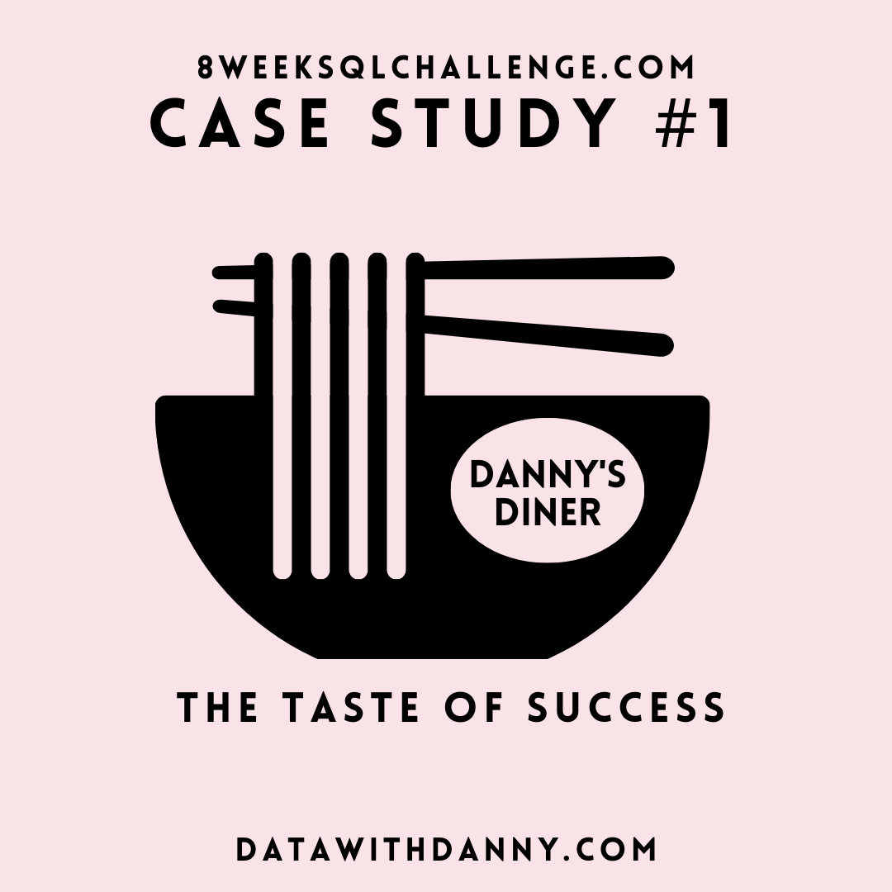
CAPESTONE PROJECT CASE STUDY 1
DONE BY THIVYA
20 JUNE 2022

Slide 2
Problem Statement
Danny is a big fan of Japanese food, so he decided to start a restaurant at the beginning of 2021 that sells his three favorite foods: sushi, curry, and ramen. Danny wants to use the data to answer a few simple questions about his customers, especially about their:
visiting patterns,
how much money they’ve spent, and
which menu items are their favorite.
This deeper connection with her customers will help her deliver a better and more personalized experience for her loyal customers. She plans on using these insights to help him decide whether she should expand the existing customer loyalty program. Additionally, she needs help to generate some essential datasets so her team can quickly inspect the data without needing to use SQL.

Slide 3
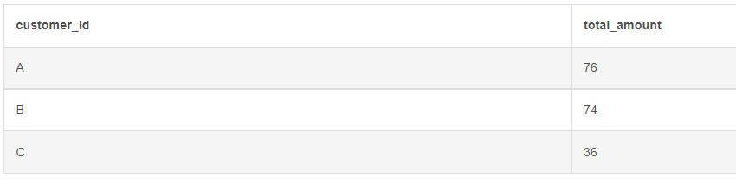
1. What Is The Total Amount Each Customer Spent At The Restaurant?
SELECT
customer_id,
sum(price) as total_amount
FROM dannys_diner.menu m
JOIN dannys_diner.sales s
ON m.product_id=s.product_id
group by 1
ORDER BY 2 DESC
UNDERSTANDING: Customers A and B are members of the loyalty program in Danny’s Restaurant and they have spent more when compared to C

Slide 4
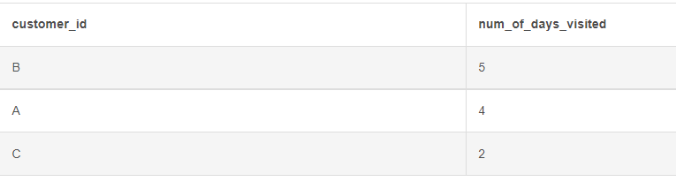
2. How many days has each customer visited the restaurant?
select customer_id,count(days) as num_of_days_visited
from (SELECT
customer_id,
extract (day from order_date) as days
FROM dannys_diner.sales
group by 1,2) sub
group by 1
ORDER BY 2 DESC
UNDERSTANDING: Membership program seems to attract customers to some level.

Slide 5
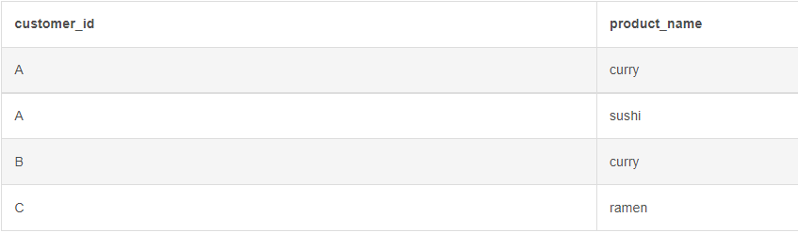
3. What was the first item from the menu purchased by each customer?
select customer_id,product_name
from(
SELECT
s.customer_id,m.product_name,s.order_date,dense_rank() over (partition by s.customer_id order by s.order_date ) as rank
FROM dannys_diner.menu m
JOIN dannys_diner.sales s
ON m.product_id=s.product_id) sub
where rank = 1
group by 1,2
UNDERSTANDING: Curry recipe is the first tried one

Slide 6
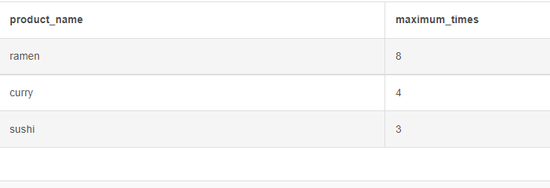
4. What is the most purchased item on the menu and how many times was it purchased by all customers?
select sub.product_name,max(sub.items_prurchased) as maximum_times
from(
SELECT
m.product_name,count(s.product_id) as items_prurchased
FROM dannys_diner.menu m
JOIN dannys_diner.sales s
ON m.product_id=s.product_id
group by 1) sub
group by 1
order by 2 desc
limit 1
UNDERSTANDING: Ramen is the most purchased item from the menu.

Slide 7
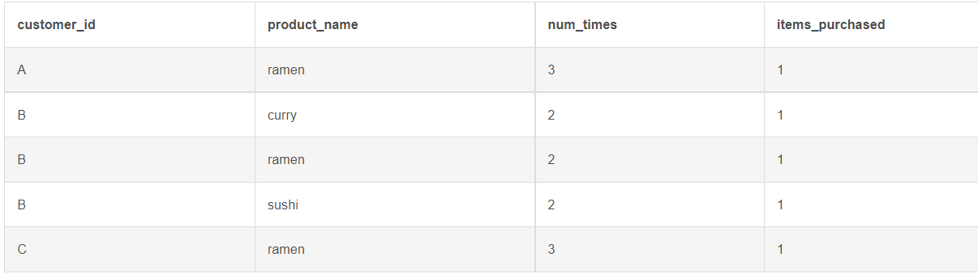
5. Which item was the most popular for each customer?
select sub.customer_id,sub.product_name,
sub.num_times,sub.items_purchased
from(
SELECT m.product_name,s.customer_id ,s.product_id ,count(s.product_id) as num_times ,dense_rank() over(partition by s.customer_id order by count(s.product_id) desc) as items_purchased
FROM dannys_diner.menu m
JOIN dannys_diner.sales s
ON m.product_id=s.product_id
group by 1,2,3) sub
where items_purchased=1
group by 1,2,3,4
UNDERSTANDING: Ramen is the most purchased item from the menu for each customer.

Slide 8
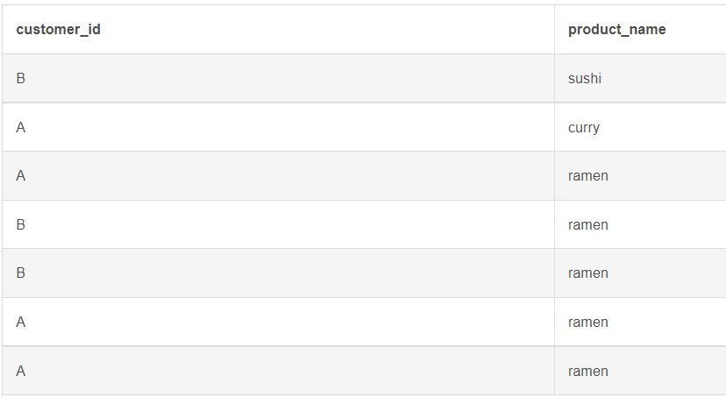
6. Which item was purchased first by the customer after they became a member?
with cte as
(select m.customer_id,m.product_id,rank() over(partition by m.customer_id order by m.order_date ) as ranking
from dannys_diner.sales m
join dannys_diner. members b
on m.customer_id=b.customer_id
where b.join_date<= m.order_date)
select A.customer_id,N.product_name
from cte as A
join dannys_diner.menu N
on A.product_id=N.product_id
UNDERSTANDING: Ramen is the most purchased item from the menu.

Slide 9
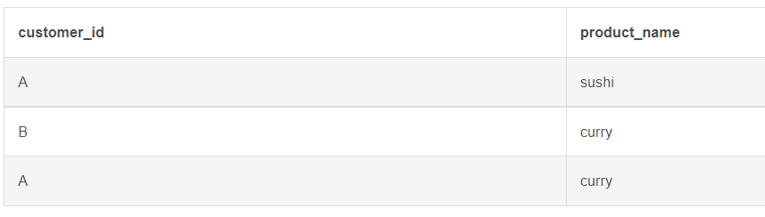
7. Which item was purchased just before the customer became a member?
with cte as
(select m.customer_id,m.product_id,rank() over(partition by m.customer_id order by m.order_date ) as ranking
from dannys_diner.sales m
join dannys_diner. members b
on m.customer_id=b.customer_id
where b.join_date>= m.order_date)
select A.customer_id,N.product_name
from cte as A
join dannys_diner.menu N
on A.product_id=N.product_id
where ranking=1
UNDERSTANDING: Ramen is the most purchased item from the menu after the customer has become member which shows that they are receiving some offer on Ramen .

Slide 10
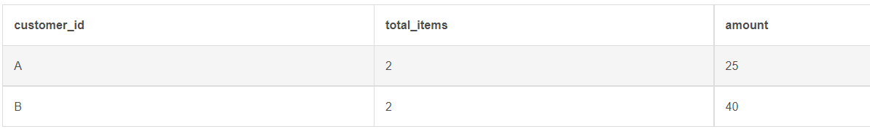
8. What is the total items and amount spent for each member before they became a member?
select s.customer_id,count(distinct s.product_id) as total_items,
sum( menus.price) as amount
from dannys_diner.members m
join dannys_diner.sales s
on m.customer_id=s.customer_id
join dannys_diner.menu menus
on s.product_id=menus.product_id
where m.join_date> s.order_date
group by 1

Slide 11
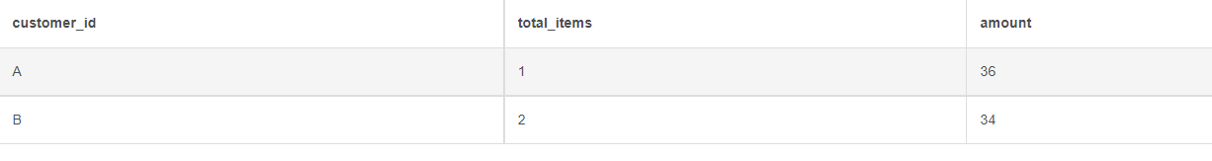
9. What is the total items and amount spent for each member before they became a member?
select s.customer_id,count(distinct s.product_id) as total_items,
sum( menus.price) as amount
from dannys_diner.members m
join dannys_diner.sales s
on m.customer_id=s.customer_id
join dannys_diner.menu menus
on s.product_id=menus.product_id
where m.join_date< s.order_date
group by 1
UNDERSTANDING: Loyalty program doesn’t seems to change the purchasing rate of the customers.

Slide 12
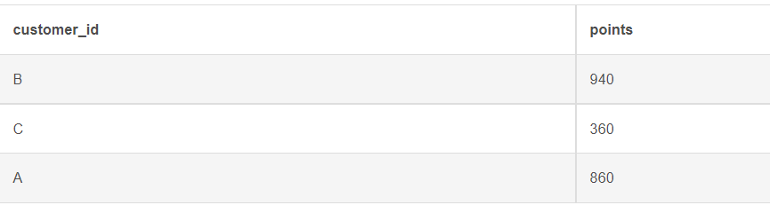
10. If each $1 spent equates to 10 points and sushi has a 2x points multiplier - how many points would each customer have?
select s.customer_id,
sum(case when s.product_id=1 then m.price*20
else m.price*10 end) as points
from dannys_diner.sales s
join dannys_diner.menu m
on s.product_id=m.product_id
group by 1;
UNDERSTANDING: Customer B is seems to purchased more sushi compared to others.

Slide 13
Bonus questions
with cte as(select s.customer_id,s.order_date,n.product_name,n.price,m.join_date,
rank() over(partition by s.customer_id order by s.order_date ) as ranking
,case when s.order_date>=m.join_date then 'Y'
else 'N' end as members
from dannys_diner.sales s
join dannys_diner.menu n
on n.product_id=s.product_id
join dannys_diner.members m
on s.customer_id=m.customer_id)
select A.customer_id,A.order_date,A.product_name,A.price,A.members
from cte A

Slide 14
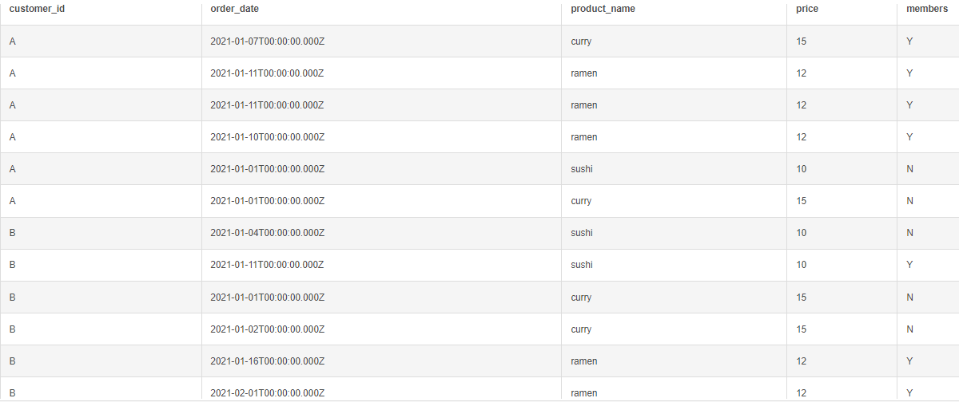
Recreating the table shown in the output with the given sales,menu and members table by using case statement,windows function & cte:

Slide 15
Rank All The Things
select A.customer_id,A.order_date,A.product_name,A.price,A.membership,
case when A.membership ='Y' then (dense_rank() over(partition by A.customer_id, A.membership ='Y' order by A.order_date ) )
else null end as ranking from
(select s.customer_id as customer_id,s.order_date as order_date,n.product_name as product_name ,n.price as price, m.join_date,rank() over(partition by s.customer_id order by s.order_date ) as ranking1,
case when s.order_date>=m.join_date then 'Y'
else 'N' end as membership
from dannys_diner.sales s
join dannys_diner.menu n
on n.product_id=s.product_id
join dannys_diner.members m
on s.customer_id=m.customer_id) A

Slide 16
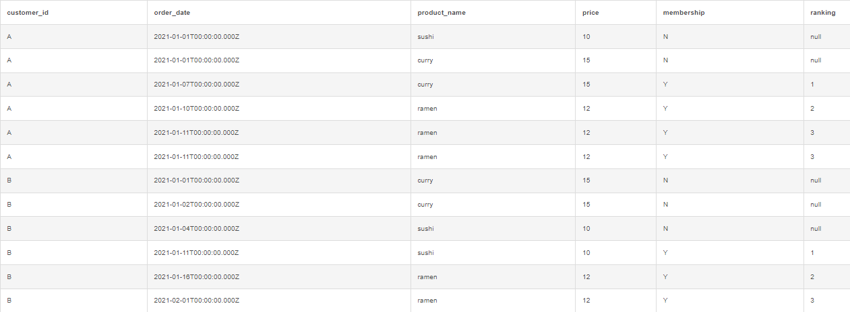
Output:

Slide 17

Recommendations:
By analyzing the data it seems that customer visits more the restaurant after they have become members.
But it seems that the recipes doesn’t attracts more for them other than ramen.
They all have attempted curry for the first time but not repeated more which shows that Danny must improve the taste by proving Chef’s special recipe for the members to improve the footfall.
They spent more on ramen and sushi so Danny can give more offers like Wednesday special or weekend special offers for the members.
He can give more points for the members of the loyalty program to encourage the customers become members of the same.

